Slide 1

School of Electrical Engineering (SEE) Minor Project Review IV Project Title SELF CARE MONITORING GLOVES based on IOT
Chaitanya Gabhane [168]
Abdul Muqueet Sahil [227]
Pragati Mundhe [258]
Omkar Mohare [174]
Guide
Prof. Aswathy M A

Slide 2
Introduction
Self Health Care Monitoring Gloves based on IOT are basically used to periodically monitor the health of people having health issues.
Health monitoring can be achieved by measuring the pulse rate, SpO2 level and temperature.
Alarming system with buzzer is for calling for any help.

Slide 3
Problem Statement
To monitor the health of old aged people , physically impaired, paralysed as well as people having speech and hearing impairment.

Slide 4
Idea of the Project
We have observed negligence in self health routine.
People does not fully know how to monitor themselves due to lack of knowledge.
Health care checkups are expensive.
To use the end product for the old age people, fully or partially deaf person.
To execute the self monitoring unit through the thought of going through the design thinking process.
To develop a sense of empathy among people towards old aged people and physically challenged people.

Slide 5
Background
Elder people, pregnant women, and children etc with health issues should periodically monitor their health.
Due to COVID-19, people are unable to go outside and monitor their health conditions.This may also require huge sum of money.
Some people in rural areas don’t have any proper bus facilities to go to hospital for periodical testing.
Complex monitoring instruments in hospitals which common people cannot understand.
People need to rely completely on doctor’s advice.
Partially or fully deaf persons are unable to fulfill there basic needs.

Slide 6
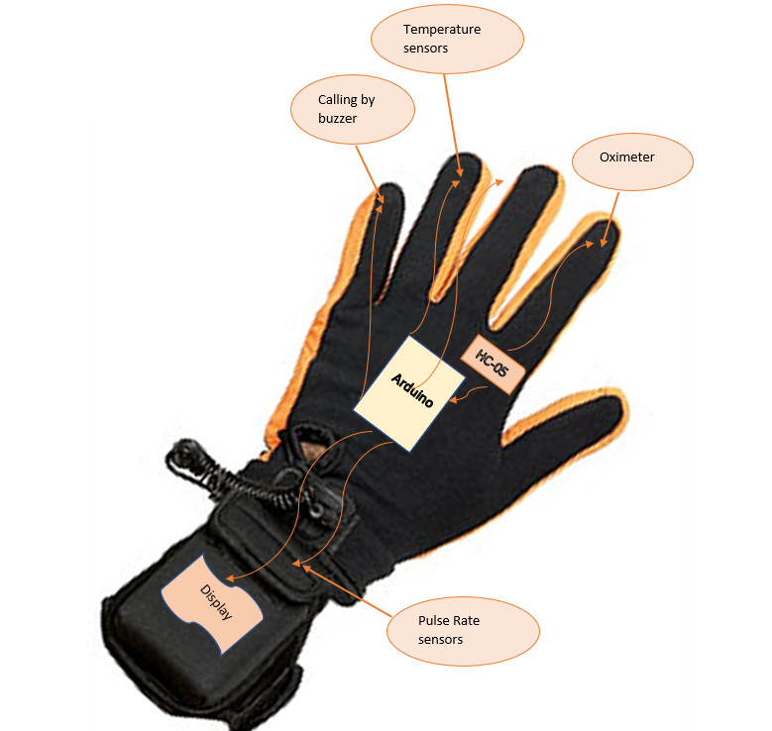
Proposed Design

Slide 7
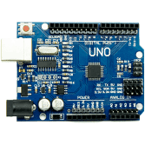
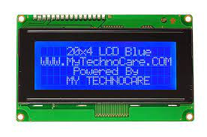
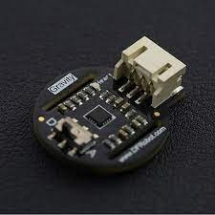
Components used
Temperature sensor :- mlx90614
Heart rate and SpO2 :-Max30102
Arduino Uno
20*4 LCD display
Batteries

Slide 8
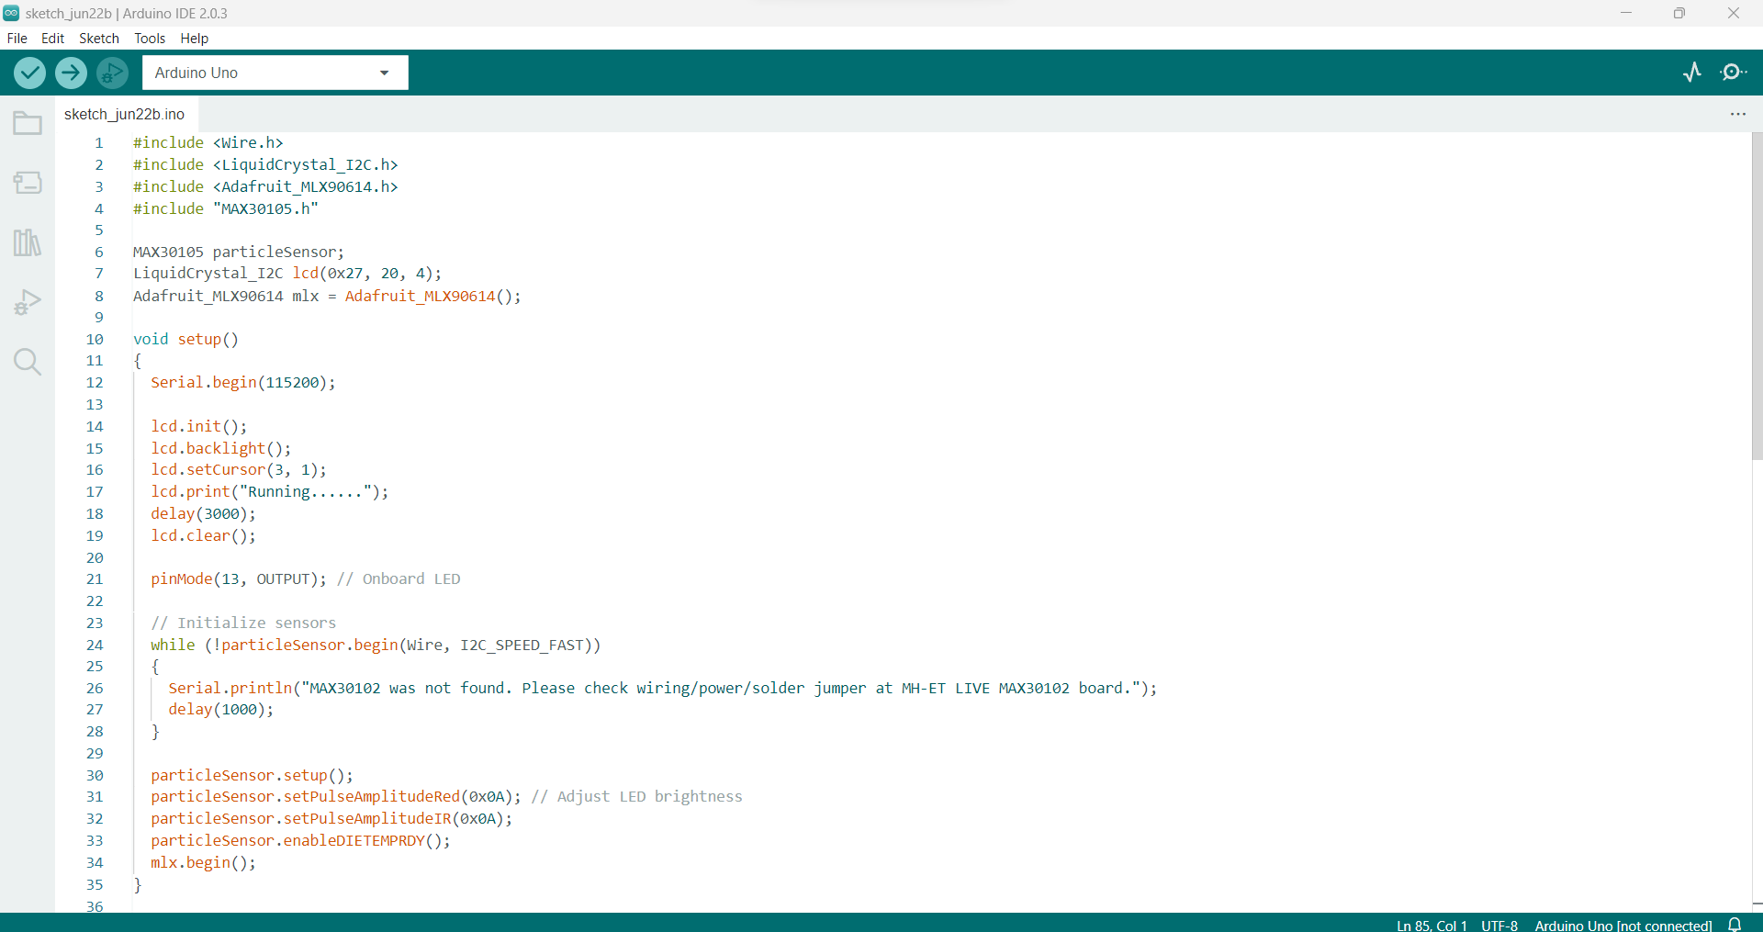
Code

Slide 9
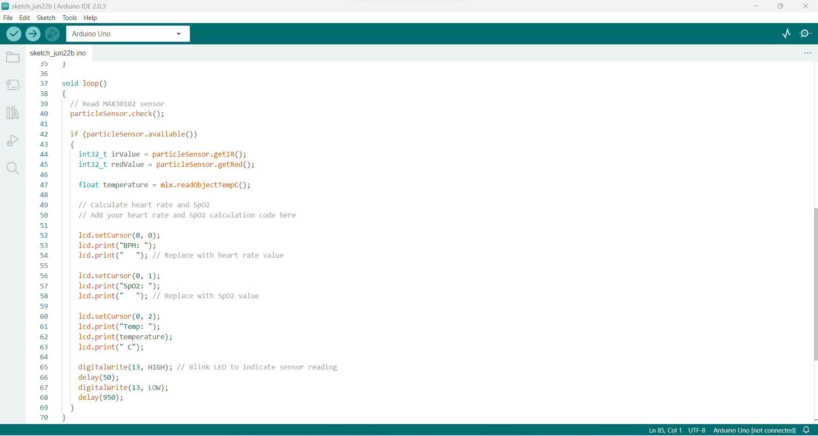
Code

Slide 10
Conclusion
Future advances in the world of IoT devices and advancements in medical facilities will be incorporated into this framework to make it more common and accessible to everyone.
Developing an effective wireless communicating device whose outcome will be an effective personal care monitoring unit

Slide 11
Resources
[1] Dutta, Debeshi, et al. "Finger movement based attender calling system for ICU patient management and rehabilitation." 2014 International Conference on Circuits, Power and Computing Technologies [ICCPCT-2014]. IEEE, 2014.
1] Shashidhar, R., Abhilash, S., Sahana, V., Alok, N. A., & Roopa, M. (2020). Iot cloud: In health monitoring system. International Journal of Scientific and Technology Research, 9(1), 227.
[2] Ambar, R. B., Poad, H. B. M., Ali, A. M. B. M., Ahmad, M. S. B., & bJamil, M. M. B. A. (2012, February). Multi-sensor arm rehabilitation monitoring device. In 2012 International Conference on Biomedical Engineering (ICoBE) (pp. 424-429). IEEE.
[3] Irjmets.com, 2021. [Online]. Available: https://irjmets.com/ rootaccess /forms/ uploads/ IRJMETS888370.pdf. [Accessed: 23- Jun- 2021].
[4] Rohit, S. L., & Tank, B. V. (2018, April). Iot based health monitoring system using raspberry PI-review. In 2018 Second International Conference on Inventive Communication and Computational Technologies (ICICCT) (pp. 997-1002). IEEE.

Slide 12
Thank You!!

